Slide 1
Analytical Methods : Regression Methods
Feb’10

Slide 2
Topics
Regression Basics
Logistic Regression
PROC LOGISTIC
Linear Regression
PROC REG
Non Linear Estimation
PROC NLIN
Mixed Regression
PROC MIXED

Slide 3
Regression
Regression is a common terminology used for establishing a relationship between dependent and independent variables
There are various techniques of regression and the user must be careful in selection of the best suited method for each scenario
Most commonly used methods other than failure-time models are :
Logistic – Modeling of events which are discrete in nature like Yes, No, Maybe or like/dislike or paid the bill, not paid the bill
Linear – Modeling of continuous variables like electricity bill, amount financed etc.
Mixed – Modeling of events where the fixed effects and random effects are significant and present
Non-Linear – Modeling of parameter estimates of a defined framework
Other forms are quite similar in nature to one of these and are uncommon

Slide 4
SAS Procedures : Regression
There are a number of SAS Procedures specially designed to handle different types of data and perform related regression
CATMOD : analyzes data that can be expressed in a contingency table
GENMOD : fits generalized linear models with discrete outcomes
GLM : performs simple, polynomial, multiple and weighted regression
LIFEREG : fits parametric model to failure time data
LOGISTIC : Models binomial and ordinal outcomes
NLIN : Non Linear Regression
ORTHOREG : Uses Gentleman-Givens method – ill conditioned data
PLS : partial least square, principal component and reduced rank regression
PROBIT : Used when dependent is dichotomous or polychotomous and independent variables are continuous
REG : Performs linear regression with many capabilities
RSREG : Performs quadratic response surface regression models
TRANSREG : fits univariate and multivariate linear models optionally with spline/other trfms

Slide 5
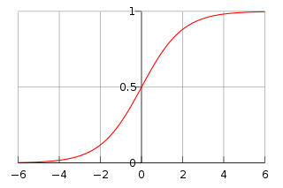


LOGISTIC/LOGIT REGRESSION
This regression methods attempts to model the probability of an event by fitting data to a logistic curve
Logistic Curve :
The model has an equivalent formulation :
where β₀ is called an intercept and β₁, β₂, β₃ are called regression coefficients of x₁,x₂,x₃
The logistic curve also called sigmoid makes sure that the values are bounded

Slide 6

PROC LOGISTIC
Used for a ordered response model with the following form
Logistic procedure also enables to choose a link function to model the form
Logistic procedure can also fit a common slope cumulative model for ordinal response variable which is a parallel lines regression model based on cumulative probabilities rather than individual probabilities and has the form
Provides four variable selection methods : Forward, backward, stepwise and best subset

Slide 7





PROC LOGISTIC (Link Function and MLE)
Logit Function is the inverse of cdf
Probit(Normit) Function is the inverse of cumulative standard normal distribution function
The complementary log-log function is the inverse of the cumulative extreme-value function or Gompertz distribution
The likelihood for j^{th} obs.with response y_{j} and independent x_{j}’s is :
where F is as above, α’s are intercept parameters, β’s are slope parameters and 1to k+1 are ordered response of the event

Slide 8
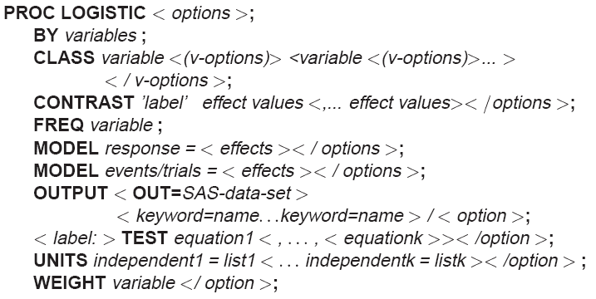
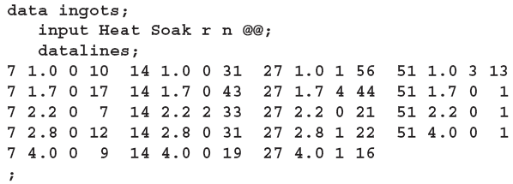
PROC LOGISTIC (Illustration)
The data, taken from Cox and Snell (1989, pp. 10–11), consist of the number, r, of ingots not ready for rolling, out of n tested, for a number of combinations of heating time and soaking time.

Slide 9

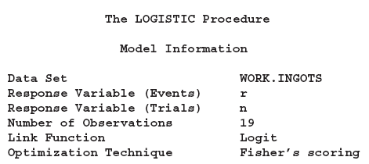

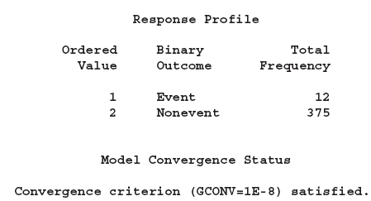
PROC LOGISTIC (Illustration)
r=12
n=389 , n-r=389-12=375

Slide 10
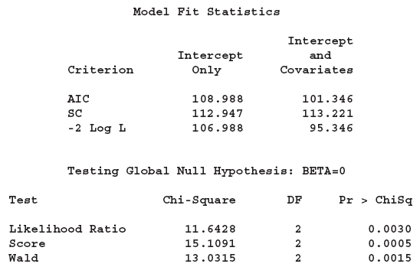
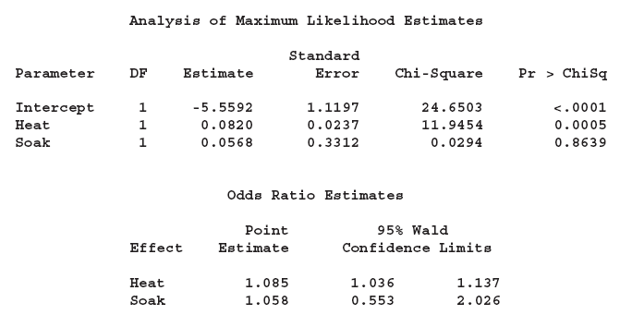
PROC LOGISTIC (Illustration)
Value for Intercept only and with Co-variate (fitted) Model – The lower the better
Akaike Information Criterion
Schwarz Criterion
-2 Log Likelihood
Results of the likelihood ratio test and the efficient score test for testing the joint significance of the explanatory variables (Soak and Heat) are included in this table
Maximum Likelihood Estimates

Slide 11
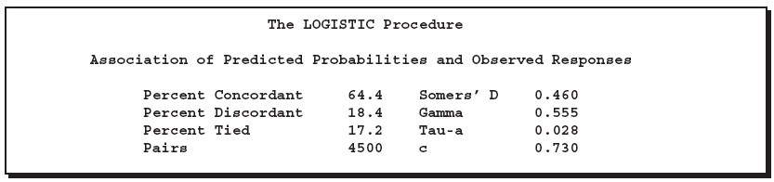
PROC LOGISTIC (Illustration)
# of pairs where event and non event probability are in the same order as response levels
(#concordant-#discordant)/Total Pairs
# of pairs where event and non event probability are in the reverse order as response levels
GoodMan Kruskal Gamma : (#concordant-#discordant)/ (#concordant+#discordant)
Kendall’s Tau -a : (#concordant-#discordant)/ (0.5*#Obs*(#Obs-1))
# of pairs which are neither concordant nor discordant
No of pairs formed by events and non event = r*n
(#concordant+(0.5*#Tied))/#Pairs

Slide 12
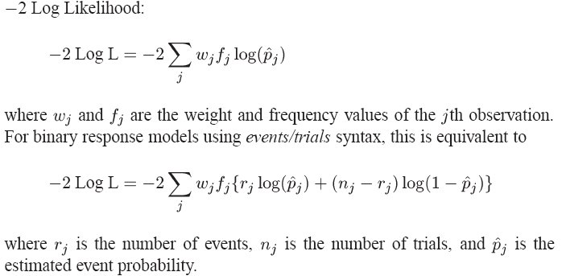
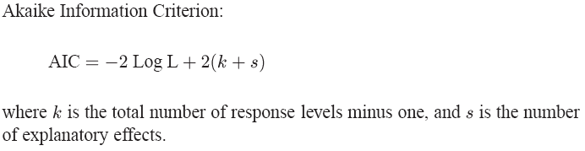
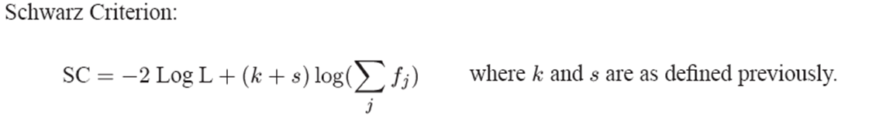
PROC LOGISTIC (Statistics)

Slide 13
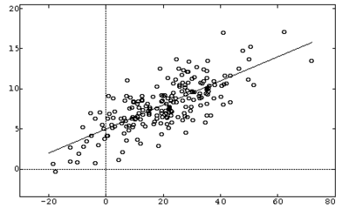
LINEAR REGRESSION
This regression methods attempts to model the probability of an event by fitting data to a linear curve
Linear regression models are often fitted using the least squares approach, but they may also be fitted in other ways, such as by minimizing the "lack of fit" in some other norm, or by minimizing a penalized version of the least squares loss function as in ridge regression
Certain assumptions in regards to independent variable distribution, error distribution need to be fulfilled in order to have a significant result
Linear Regression for a single independent variable.

Slide 14

PROC REG
Used for a continuous response variable Y which can be predicted by a linear function where β₀ is the intercept and β₁ is the slope parameter and ε_{i} is the error term
Procedure provides the following flexibilities :
Multiple MODEL statement
Nine model selection method (None, Forward, Backward, Stepwise, MAXR, MINR, Rsquare, AdjRSq, Cp)
Interactive changes

Slide 15
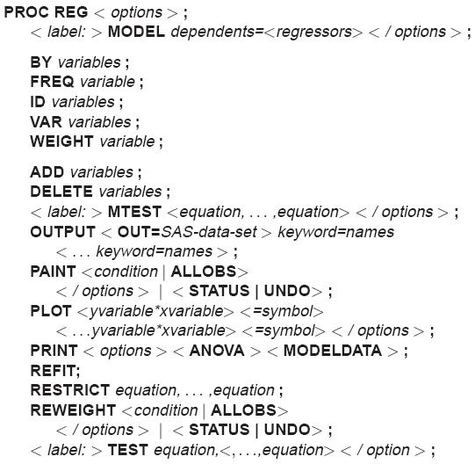
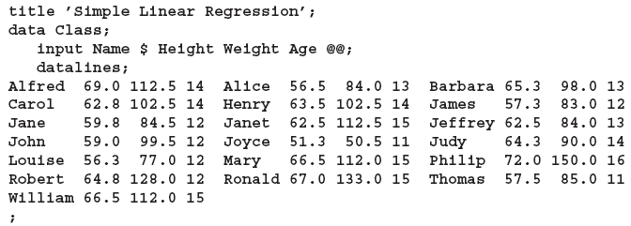
PROC REG
You might use regression analysis to find out how well you can predict
a child’s weight if you know that child’s height. The following data are from a study of nineteen children. Height and weight are measured for each child.

Slide 16

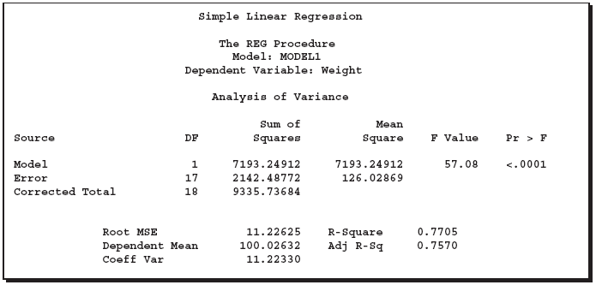
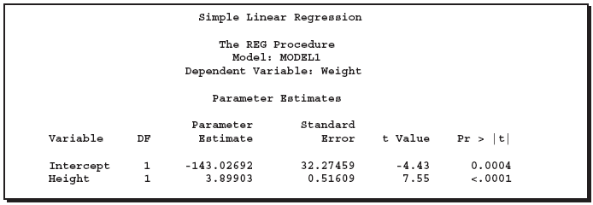
PROC REG
Already explained in the ANOVA section
Parameter estimation is done using least square technique
Parameter Estimate/Standard Error

Slide 17


Non Linear Estimation
Non-Linear Estimation is a generalized fitting procedure to estimate the relationship between dependent and independent variables
Linearization : Certain Non Linear Problems could be moved into a linear domain by suitable transformation
The use of linearization however must be done with caution due to its influence on data impacting statistical inferences like error/variance

Slide 18

PROC NLIN
This procedure produces least squares or weighted least squares estimates of the parameters of a nonlinear model
There is however no assurance of a successful model fit from the proc
PROC NLIN provides the flexibility to
Confine the ranges of parameter values within certain bounds
Define objective function to be minimized
It has five iterative methods to be used (Gradient, Newton, Gauss-Newton, Marquardt, False Position (DUD))
It can also accommodate array operations, if then else functions, do while operations, data creation steps etc.
It can perform segmented modeling as well for equations like

Slide 19
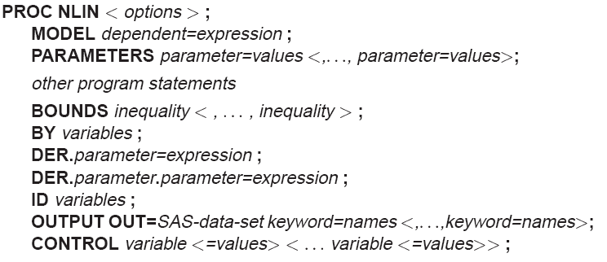
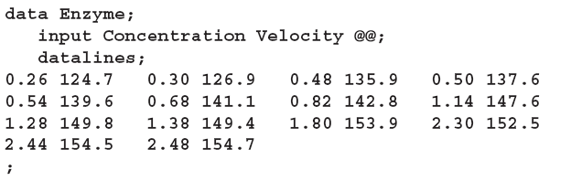

PROC NLIN
Suppose that you want to study the relationship between concentration and velocity for a particular enzyme/substrate pair. You record the reaction rate (velocity) observed at different substrate concentrations. We know from enzyme kinetics that
Where x_{i} is the substrate amount, f the velocity of reaction and θ the rate parameter

Slide 20
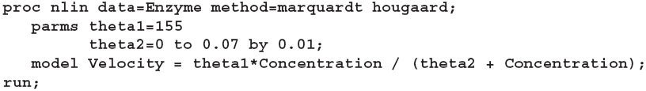
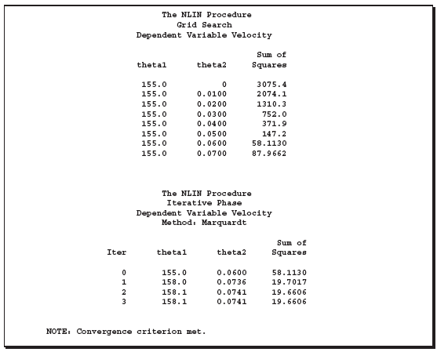
PROC NLIN (Illustration)
Parameters of the model specified by parms start with initial values

Slide 21
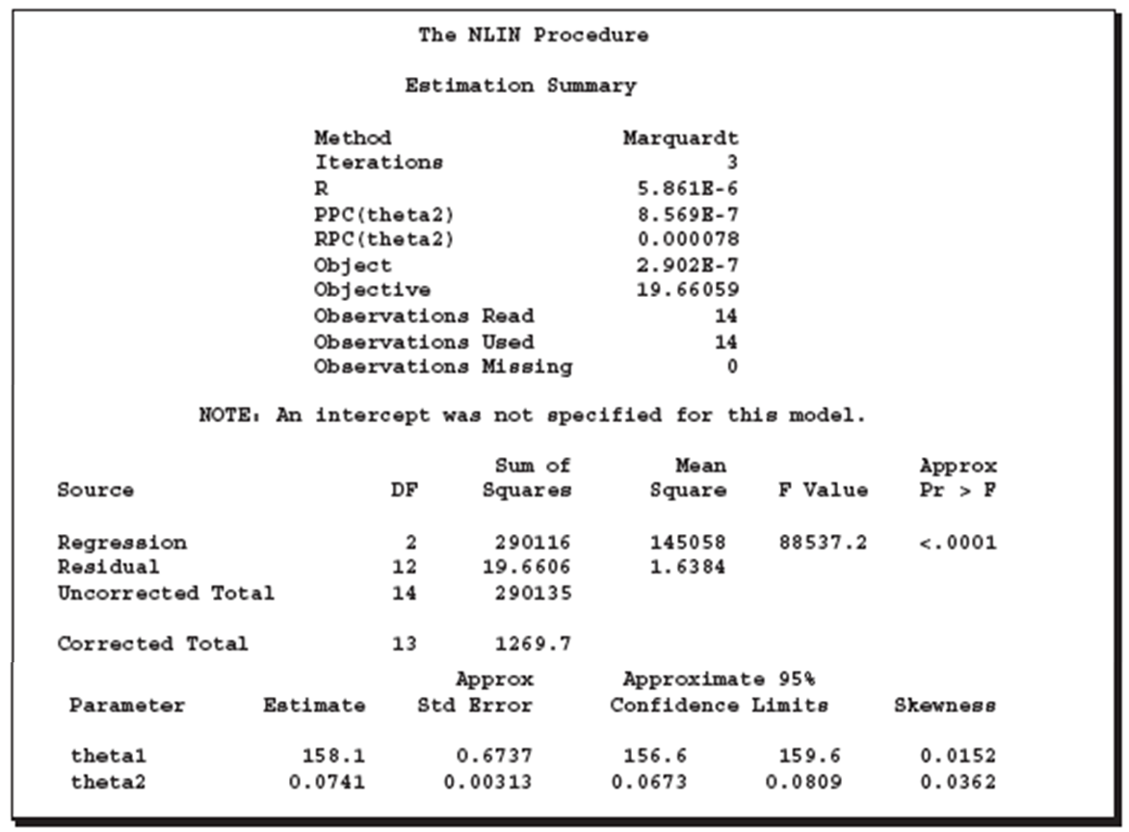
PROC NLIN (Illustration)

Slide 22
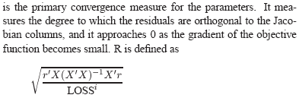
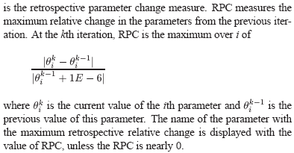
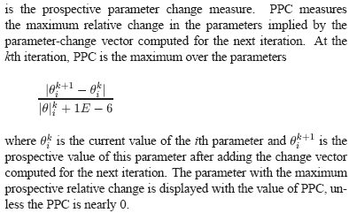
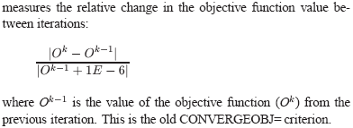
PROC NLIN (Converges Measures)
R
RPC
PPC
OBJECT

Slide 23
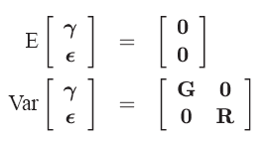
MIXED Regression
It is a generalization of the standard linear model where the data is permitted to have correlation and non constant variability
This technique provides the way to model not only the means of the data – Fixed effects Parameters but also the variance and covariance – Covariance Parameters
The mixed model generalizes the standard linear model as follows:
where γ is an unknown vector of random-effects parameters with known design matrix Z. ε is an unknown random error vector whose elements are no longer required to be independent and homogeneous
A key assumption in the foregoing analysis is that γ and ε are normally distributed with The variance of y is therefore

Slide 24
PROC MIXED
This procedure fits a variety of mixed linear models to data and enables development of statistical inferences from the data
Assumptions to be followed :
Data must be normally distributed
Means are linear in other independent variables
Variance and Co-variance of data are in terms of different set of parameters
It fits the selected structure using the method of restricted/residual maximum likelihood (REML)
Procedure uses Newton Raphson method for iteration and estimation of fixed and random effects

Slide 25
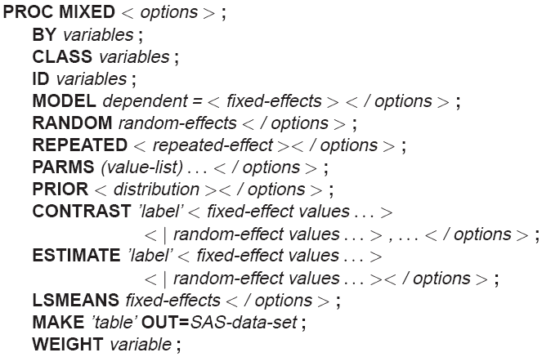
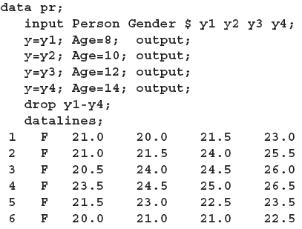
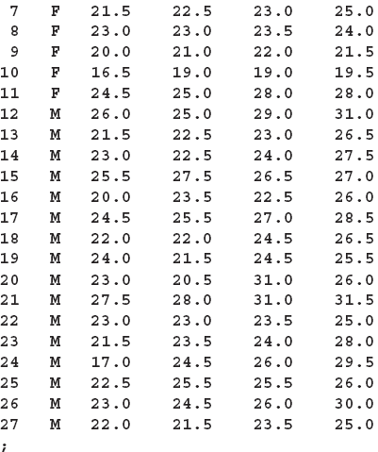
PROC MIXED
The following data are from Pothoff and Roy (1964) and consist of growth measurements for 11 girls and 16 boys at ages 8, 10, 12, and 14. Some of the observations are suspect (for example, the third observation for person 20); however, all of the data are used here for comparison purposes.

Slide 26
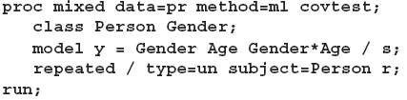
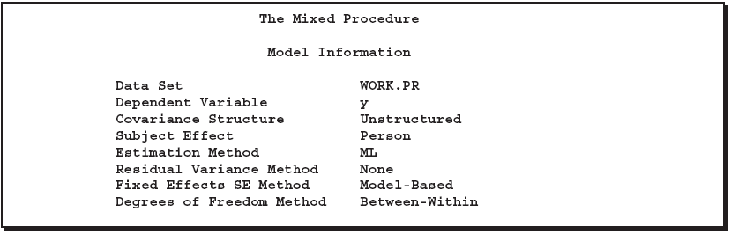
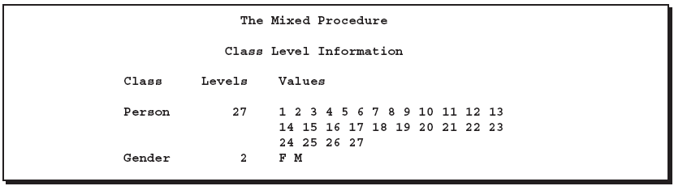
PROC MIXED
Number/Cardinality
Unique Values

Slide 27
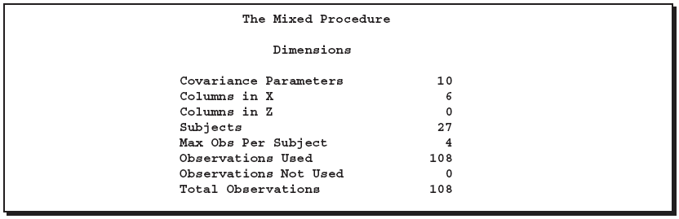
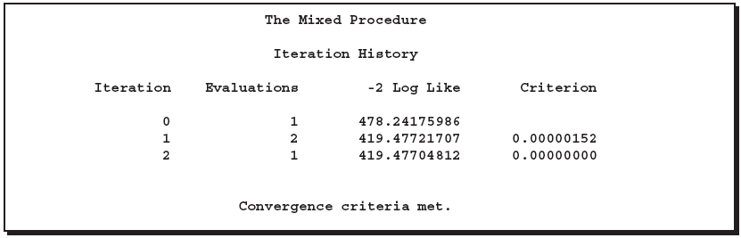

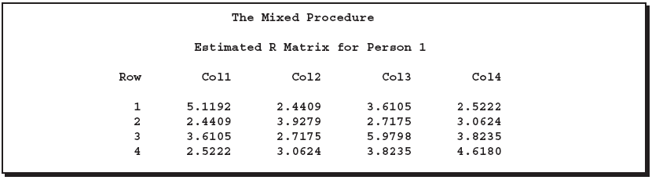
PROC MIXED
4 obs are present per object i.e. 4 ages per person hence Co Var Parameters are ⁴C₂+4 = 10
# of fixed effects : 2 for Gender, One for Age,2 for Age*Gender and One for Intercept, governed by model statement
Random Statement is not specified hence Z matrix is not required
Total # of observations in the data set
Modified Log Likelihood

Slide 28
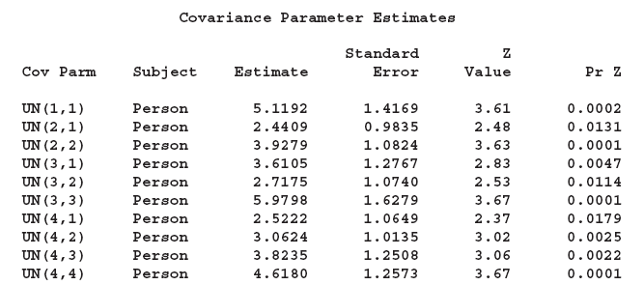
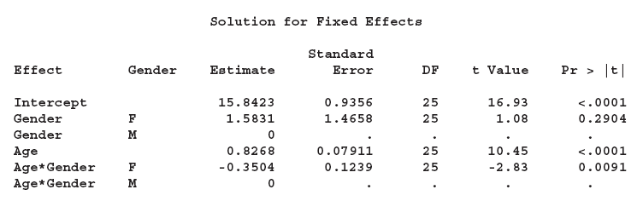
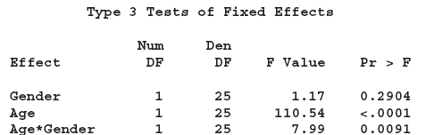
PROC MIXED
Solution for the fixed effects / Linear regression

